Slide 1
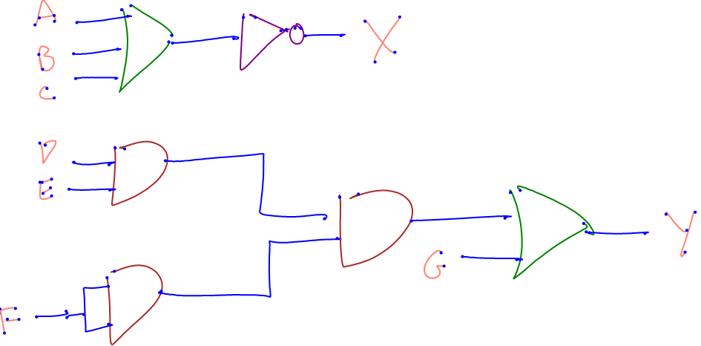
I/O Recognition
Simulation requires knowing the inputs and outputs of each circuit, but how can these be identified?
output
internal
input

Slide 2
I/O Recognition
Machine learning
  Multilayered neural net
Feature considerations
  I/O wires usually labeled
  I/O wires have one endpoint not connected
  Inputs on top or left side
  Outputs on bottom or right side

Slide 3
Feature Selection
Feature set
  Endpoint distance to perimeter lines
  Distance from wire to closest label
  Distance from wire endpoint to closest gate
  Distance from wire endpoint to closest wire

Slide 4
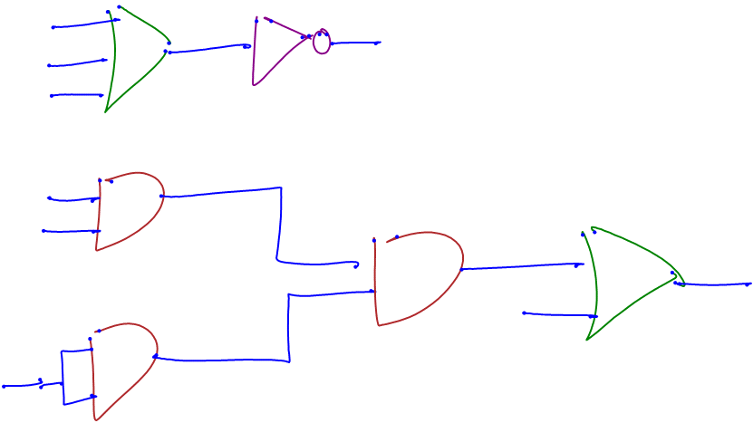
Selected Features
Endpoint distance to perimeter lines

Slide 5
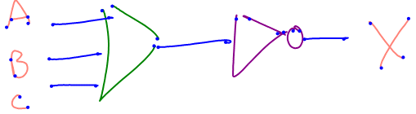
Selected Features
Distance from wire to closest label

Slide 6
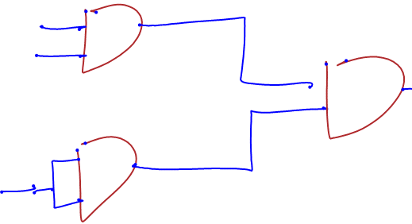
Selected Features
Distance from wire endpoint to closest gate

Slide 7
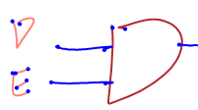
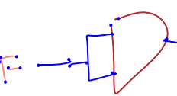
Feature Selection
Distance from wire endpoint to closest wire

